Slide 1

ST. PAUL CATHOLIC ELEMENTARY SCHOOL
AGM Wednesday October 6, 2025

Slide 2

Prayer
Loving God,
As we gather this evening as a school community, we pause to remember.
We remember the men and women who have served, sacrificed, and given their lives for the gift of freedom we enjoy today.
May their courage inspire us to live with integrity, compassion, and hope.
We pray for peace in our world, in our country, and in our hearts.
Help us to be peacemakers in our words and actions, building a community rooted in love and understanding.
Bless our discussions tonight — guide our decisions so that they may serve the good of all our students, families, and staff.
May we always seek to follow the example of Jesus, who taught us to love one another.
We ask this through Christ our Lord.
Amen.

Slide 3
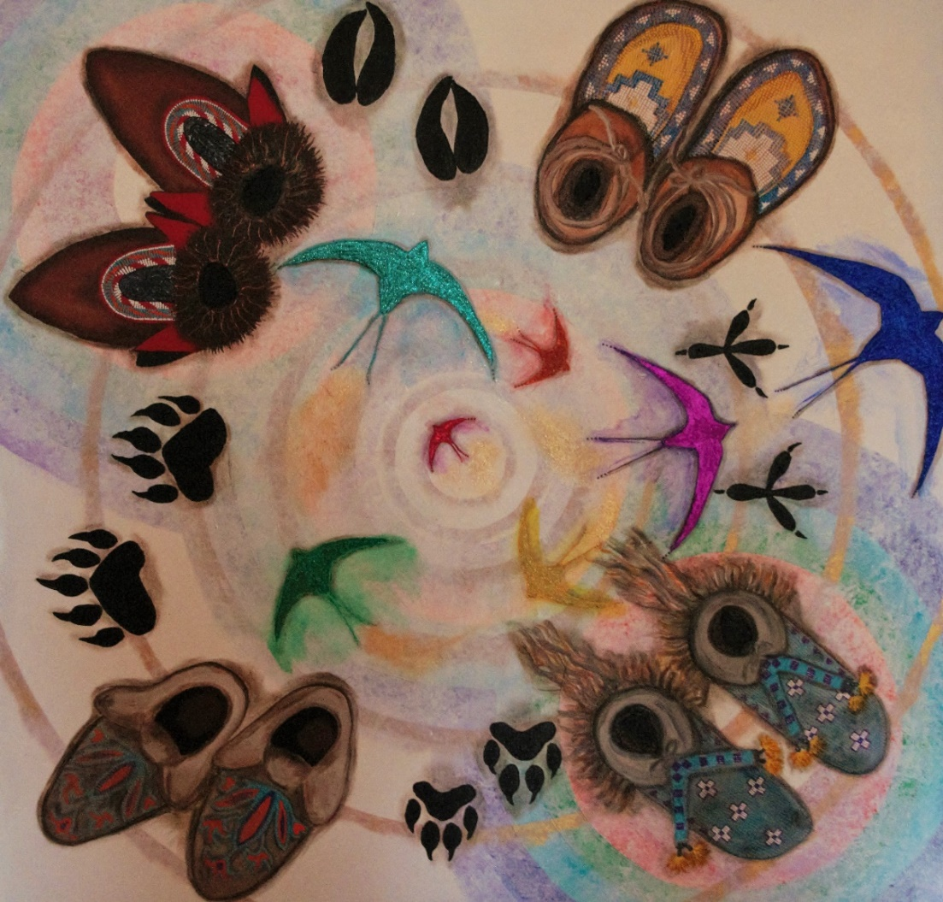
Treaty Acknowledgement
We acknowledge that treaty six territory, on which we stand, is the ancestral land to the indigenous peoples, and is home to everyone in virtue of God, our Creator’s,’ gracious gift.
We are the Tree of Hope,
We are a people of Spirit,
We are a Nation of strength,
We are our Elders’ Love,
We are Mother Earth's prayers.

Slide 4
St. Paul school
School Council Meeting AGM
October 8, 2025 @ 6:30 PM
Agenda
1. Call to Order
  Prayer
  Treaty 6
  Roll Call (please sign attendance sheet)
2. Approval of Minutes/ Agenda
  May 21, 2025 - minutes
  October 8, 2025 – Agenda
3. Administration Report
4. Old Business
5. New Business
  Review of Admin Procedure 110
  Vote of 2025-2026 SAC Executive
      Chair
      Co-Chair
      Secretary
      Treasurer
  Vote in Members of the Board
  Committee & Room Rep Overview
6. Adjournment
  Next Meeting – December 3, 2025

Slide 5
Approval of minutes/ Agenda
May 21, 2025 - minutes
October 8, 2025 - Agenda

Slide 6

ADMINISTRATION REPORT

Slide 7



Division theme

Slide 8






Division Plan for Continuous Growth
2023-2026 | Year 3
Living our Faith
Learning Excellence
Embracing Diversity
Organizational Excellence

Slide 9



Slide 10



Slide 11
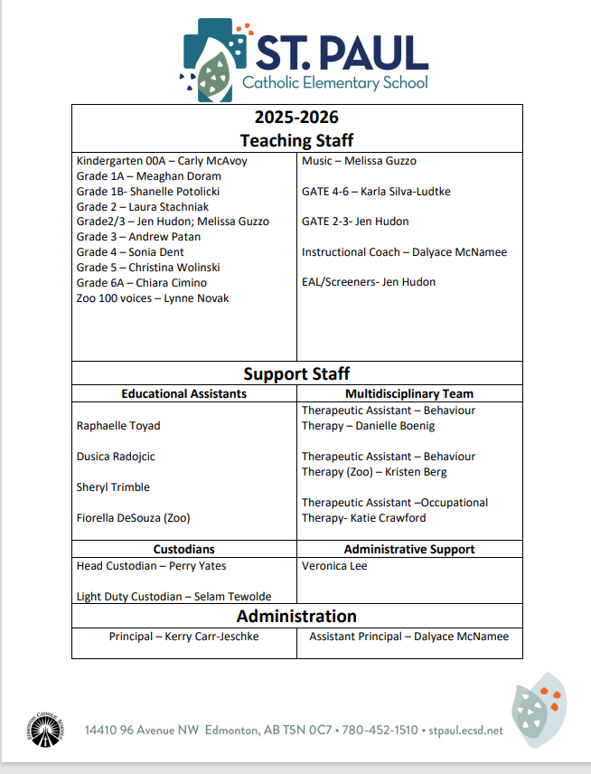
Meet the Staff

Slide 12
Enrolment
(2025-2026: 225 Students)
Kindergarten | 24
Grade 1 | 49
Grade 2 | 27
Grade 3 | 35
Grade 4 | 32
Grade 5 | 28
Grade 6 | 29
100 Voices | 30
Total | 254
Gifted and Talented Education
Cohort 1 (Gr. 2/3) | 19
Cohort 2 (Gr. 4/5) | 14
Grade 6 | 3
Total | 36

Slide 13
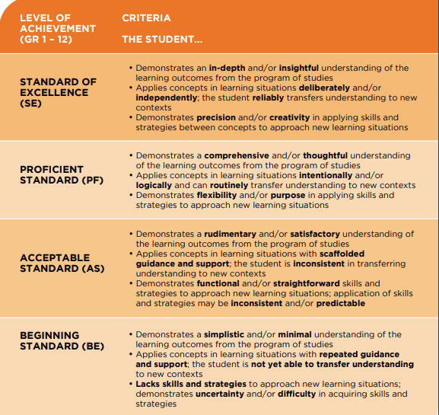
Assessment & reporting
Power Teacher Pro
  Assignments WILL be published
  Outcomes based
  Legacy (Social 4-6) and New Curriculum reported
  Learner Skills reporting
  November –Demo of Learning
  January - Summary report for parents (Grades 1-6)
  March – Student-led Conference
  June - Summative Report Card (K-6)

Slide 14
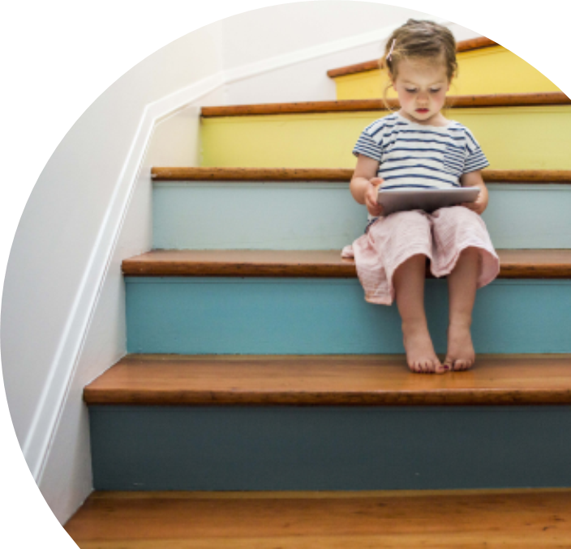

How Are WE Communicating Student Learning to Parents
Our School-Wide plan for making learning visible…
  Posting levels of achievement into Power school on an ongoing basis
Friday Emails
  linked directly to curriculum
  Summary of the week (general)
Friday Folder
  Sharing pieces of student work (1-2x per month)
  Ongoing Portfolio (Summative)
General parent communication
Principal Weekly Memo
January & June Summary Report Cards

Slide 15

Items to celebrate
School Opening Mass – September 12, 2025
New Social Curriculum (K-3)
Kinder to Grade 2 Skating
Leadership Team
Terry Fox Run
Cross Country Run
Orange Shirt day
Halloween Parade and class parties
Remembrance Day Observation

Slide 16

2025-2026 school-based professional development days
  Fall Break November 10-12
  November 28 PD Day- CANCELLED; will be rescheduled in the new year
WEDNESDAY, FEBRUARY 25, 2025
  Teacher’s convention February 26 & 27
  Friday May 15th- No School

Slide 17
Calendar of events
November
7- School Picture Day
10-12 Fall Break –enjoy!
17- Grade 6 Immunizations
20- Grade 4 Bible Celebration @ 10:30 AM
21- Grade 1 & 2 Fused Glass in school FT
27 - K-6 Demo of Learning 1-5 PM
28 – Movie Afternoon- donations in support of the ECSD Dream Builder’s Fund
December
5- Picture Retake Day; Grade 3s at TWOS
11- Kinder A at the Zoo AM
18- Pancake Breakfast & St. Paul Cozy Christmas Caroles

Slide 18
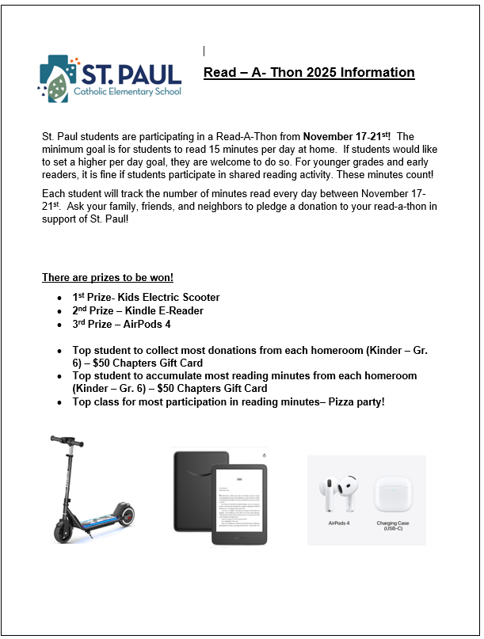
Read a thon!

Slide 19
Demo of Learning
Drop In
November 27
As we settle back into the school year following the recent learning interruption, we have decided to adjust the format of our upcoming Parent-Teacher Interviews on November 27.
Instead of scheduled interview times, we will be hosting a Drop-In “Demonstration of Learning”.
Parents and guardians are welcome to stop by the school anytime between 1:00–5:00 PM to visit classrooms, view student work, and connect with your child’s teacher.
If you are unable to attend during those hours but would like an opportunity to speak with your child’s teacher, please reach out to them via email to arrange a phone conversation or an alternate meeting time.

Slide 20

Christmas Concert

Slide 21
St. Paul social justice Christmas project
Over the month of December, we will be collecting items for ECSD’s Centre for Diverse Learners (CFDL)
CFDL houses many of our Division programs for students with complex and diverse needs
They will be creating hampers for families to take home over the holiday break and are looking for items such as:
  Boxes of cereal
  Boxed macaroni and cheese
  Snacks- granola bars, bear paws, goldfish, ritz crackers, veggie straws. Etc.
  Ramen and canned soups
  Dry pasta and jarred sauced
  Toques and mittens

Slide 22
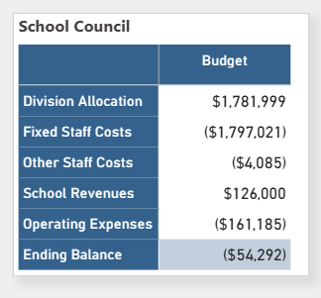
School budget

Slide 23

What is a School Council?
School councils are structured groups of parents, principals, teachers, secondary students and community representatives who work together to effectively support and enhance student learning. They provide a means for members of the school community to consult with and provide advice to the principal and the school board.
What School Councils are Not:
As the primary role is advisory, school councils are not eligible to incorporate as societies. It is not the primary intent of school councils to fundraise or lobby.
Roles that are not to be taken on by a school council include:
• school governance
• employment issues
• school management
• listening to complaints
St. Paul School Council - website

Slide 24
new business
  Vote of 2025-2026 SAC Executive
      Chair
      Co-Chair
      Secretary
      Treasurer
  Vote in Members of the Board

Slide 25
Chair
School Council Chair
It is expected that the school council chairperson will be a parent of a student attending the school. The chair should be someone who can work collaboratively and knows how to organize both programs and people. The chair should actively encourage others to become engaged in meaningful ways.
Typical chairing duties include:
  chair all meetings of the school council
  coordinate with the principal to establish meeting agendas
  ensure that the operating procedures are current and followed
  be the official spokesperson of the school council
  ensure there is regular communication with the whole school community
  stay informed about school board policy that impacts school council
Comply with the School Councils Regulation by providing the school board with an annual report that summarizes the school council’s activities for the previous school year, including a financial statement relating to money, if any, handled by the school council
Chair’s Relationship with the Principal
  The chair‘s role is key to the success of the school council. An important responsibility is regular and ongoing communication with the school principal. This relationship of mutual trust and respect must be nurtured and supportive of common goals for the learning community.

Slide 26
Co-chair
Typically, the vice-chair‘s duties are, in the event of resignation, incapacity or leave of absence of the chair, to fulfill the chair’s responsibilities, and in the absence of the chair, supervise the affairs and preside at meetings of the school council.

Slide 27
Treasurer
If the school council is handling money, through fundraising activities or donations, the treasurer keeps accurate records of all financial transactions and ensure that records are available upon request of the school board or school community.

Slide 28
Secretary
The school council secretary typically acts as a recorder at each meeting and ensures that the minutes are prepared accurately to reflect the directions agreed to at the meeting.

Slide 29
MEMBERS AT LARGE

Slide 30
COSC (Community of School Councils)
You are invited to join us for a Community of School Councils (COSC) event on November 18, 2025. This session will give you the opportunity to:
· Meet your Board of Trustees
· Learn about the work ahead for the Division
· Share your school community’s perspectives
· Participate in guided conversations
Event Details
·Date: November 18, 2025
o Arrival and light refreshment: 6:00 – 6:30 PM
o Presentations and feedback gathering: 6:30 – 8:30 PM
o Thanks and Closing Prayer: 8:30 PM
· Location: Leadership Hall, Lumen Christi Catholic Education Centre, 9405 50 Street NW.

Slide 31
Meeting Adjourned

Slide 32
St. Paul
Parent Advisory Committee Meeting #1
November 6, 2025 (post school council)
Agenda
Call to Order
Approval of Minutes/ Agenda
  May 21, 2025 - minutes
  October 8, 2025 – Agenda
Treasurer’s Report/ Financial Overview (2025-2026)
School Budget 2025/26 - Review & Approval
Adjournment

Slide 33
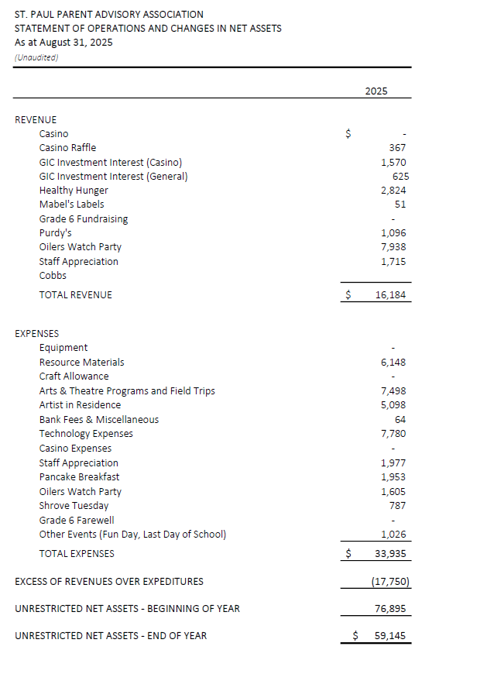

Slide 34
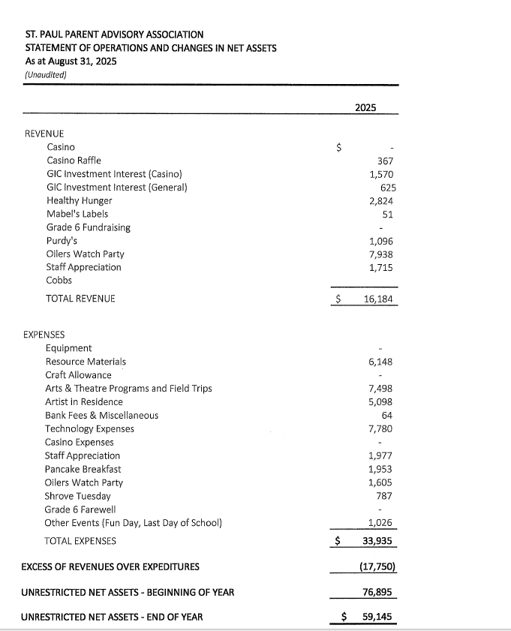

Slide 35
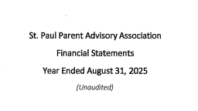
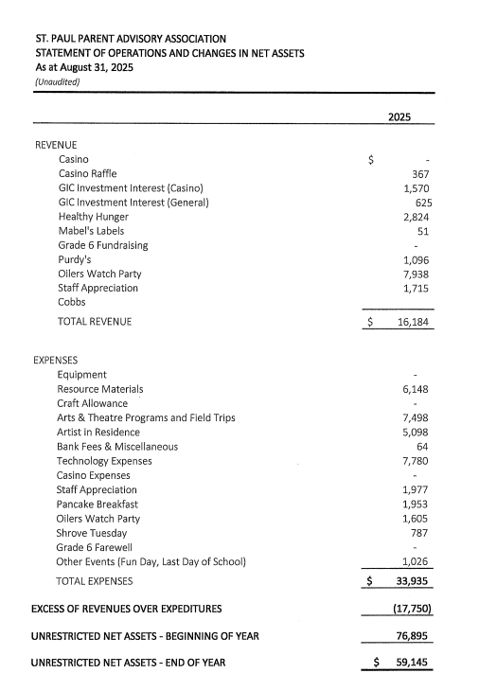
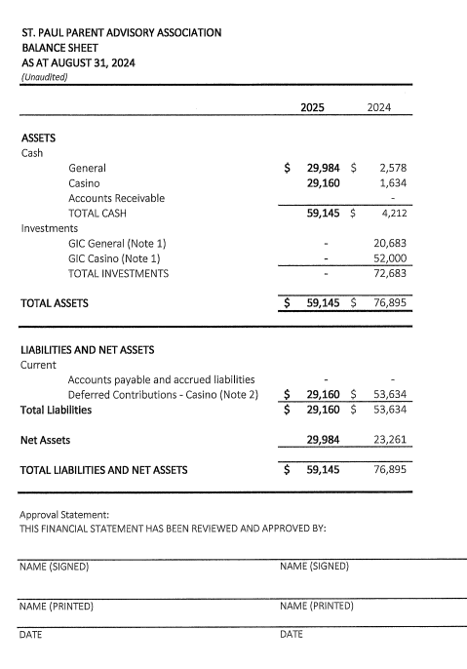

Slide 37
Healthy Hunger | $ 2,823.67
Mabels Labels | $ 50.79
Raffles | $ -
Grade 6 fundraising | $ -
Purdy's | $ 1,096.20
Oilers Watch Party | $ 7,937.50
Staff Appreciation | $ 1,715.00
TOTAL | $ 13,623.16
St. Paul Parent Advisory Association – 2024/25 Fundraising Revenue

Slide 38
Staff Appreciation | $ 1,977.28
Resource Materials | $ 132.20
Craft Allowance | $ -
Pancake Breakfast | $ 1,952.55
Oilers Watch Party | $ 1,604.81
Shrove Tuesday | $ 786.50
Grade 6 Farewell | $ -
Other Events | $ 1,026.35
Casino Expenses | $ -
Bank Fees | $ 44.55
TOTAL | $ 7,524.24
St. Paul Parent Advisory Association – 2024/25
General Expenses
$3046 below budget

Slide 39
Equipment | $ -
Resource Materials | $ 6,015.45
Arts & Theatre Programs and Field Trips | $ 7,498.04
Artist in Residence | $ 5,097.75
Bank Fees | $ 19.05
Technology Expenses | $ 7,780.00
TOTAL | $ 26,410.29
St. Paul Parent Advisory Association – 2024/25
Casino Expenses
$10, 090 below budget

Slide 40
General | $ 30,216.71
Casino | $ 29,160.29
St. Paul Parent Advisory Association –
Current Bank Balances
Casino Funds must be spent prior to May 2027

Slide 41
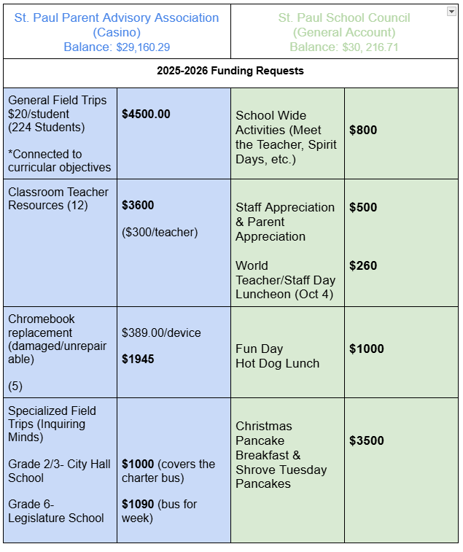
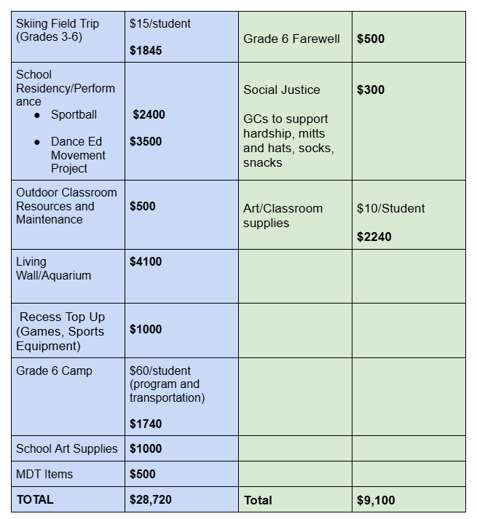
school budget proposal

Slide 42
Fundraising – parent committees
Goal $10 000/ school year
Healthy Hunger
Purdy’s (Christmas & Easter)
Bottle Drive (in the past supported Gr. 6 Farewell)
Raffle Baskets (Halloween/ Valentines/ Easter)
Oilers Watch Party
Cobs
Mabel’s Labels

Slide 43
Oilers watch party
Set for Saturday, April 11th at 2 PM (here at the school)
Looking for a new lead/committee
Most important item is to book Hunter ahead of time

Slide 44
Meeting Adjourned

